Slide 1

Welcome to Year 2/3
St Peter’s

Slide 2
Our Team
Mrs Stephenson – Class Teacher
Teaching Assistant- Miss Earnshaw

Slide 3
Reading
3 reads will continue for the Year 2 children to begin with.
The Year 3 children will continue with their formal comprehension lessons, building on the skills from Year 2.
Most children will bring their books home on Tuesdays and will be expected to bring them back to school on Mondays.

Slide 4
Phonics and Spelling
Children will recap phonics throughout the spelling curriculum.
Spellings lessons will be taught at separate times based on what each child needs to cover.
Children currently accessing phonics interventions will continue to access this provision teaching.
Children in Y2 cover the Y1 spelling rules followed by the Y2 spelling rules.
Children in Y3 cover the Y3 spelling rules.

Slide 5
Spelling homework
Children will be given a spelling test every Wednesday where they will learn and be tested on these spellings each week.
Year 2 children | Year 3 children
These children will have 5 spellings each week. We will start by covering the Y1&2 words and then tests will be focused on the spelling pattern taught that week. Please take a look at the Year 1 & 2 word list. These are spellings that the children must learn by heart. | Many of the Year 3 pupils will now have 10 spelling each week. 5 will be on the Year 3 words and the other 5 will be on the spelling pattern.

Slide 6
Maths

Slide 7
Times Tables Rock stars!
A program that is being used to develop times tables skills from Y2-Y6
Games based activities and competitions to develop the skills
Children all have their own login information and rock star avatars.
I will introduce this to the Year 2 children later in the year.

Slide 8
Writing

Slide 9
Year 2 SATS
No longer mandatory
The school will use SATs papers as part of the assessment programme.
Reading
Writing
Arithmetic & Reasoning

Slide 10









Wider Curriculum

Slide 11
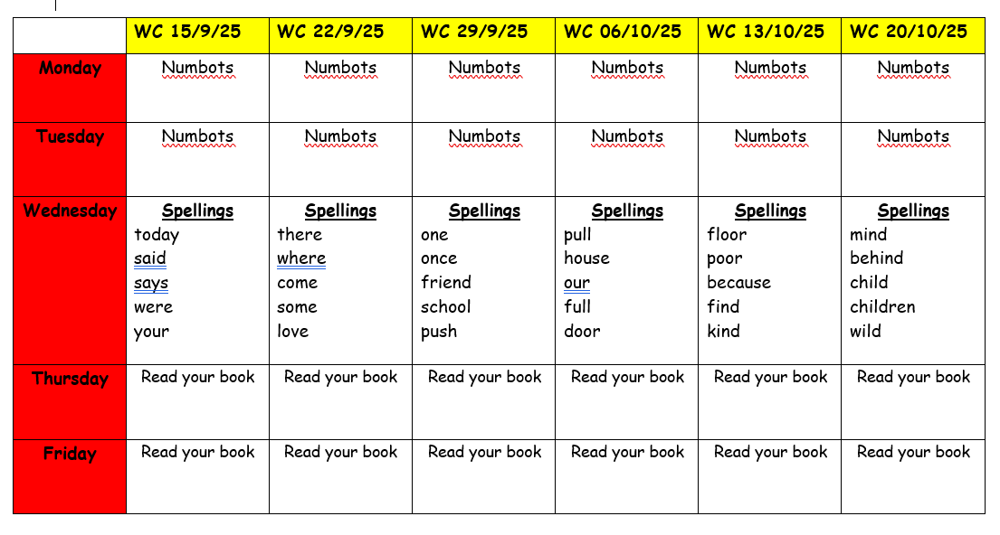
Homework

Slide 12
Thank You

